Slide 1
Market Demand and Market Equilibrium

Slide 2
Market Demand
The sum of all quantities of a good or service demanded per period by all the consuming units buying in the market for that good or service.

Slide 3
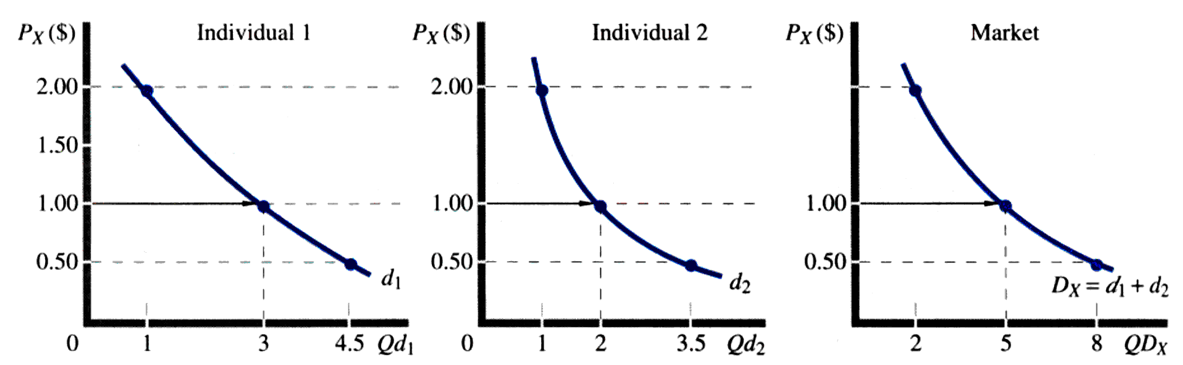

Slide 4
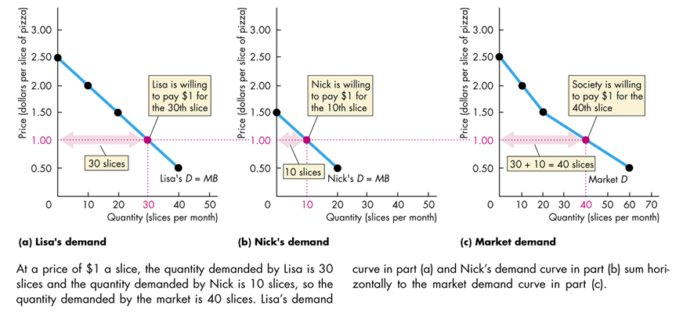
Horizontal Summation: From Individual to Market Demand

Slide 5
Determinants of Market Demand
Price of the product
Number of consumers
Consumer preferences
Income
Prices of other related products

Slide 6
Market Demand Function QD_{X} = f(P_{X}, N, I, P_{Y}, T)
QD_{X} =
P_{X} =
N =
I =
P_{Y} =
T =
quantity demanded of commodity X
price per unit of commodity X
number of consumers on the market
consumer income
price of related (substitute or complementary) commodity
consumer tastes

Slide 7
MARKET DEMAND EQUATION
Q_{d} = B + a_{p} P + a_{i} I + a_{o} P_{o} + a_{t} T
where a_{p} , a_{i} , a_{o} , a_{t} are coefficients
Q_{d} = B + a_{p} P
where a_{p} < 0 (Negative relationship)

Slide 8
Market Equilibrium
Equilibrium occurs where the demand curve and supply curve intersect
Q_{d} = f(P) and Q_{s} = g(P)
Q_{d} = a + bP where b < 0 (-ve relationship)
Q_{s} = c + dP where d > o (+ve relationship)
Q_{d} = Q_{s}
a + bP = c + dP
P_{e} = c - a
b - d
Q_{e} = a + b* c - a
b - d

Slide 9
Market Equilibrium: Surplus and Shortage
Market
Demand
200 Buyers
6
5
4
3
2
1
0
Market
Supply
200 Sellers
6,000 Bushel
Surplus
S
P
Q_{d}
P
Q_{s}
2,000
4,000
7,000
11,000
16,000
$5
4
3
2
1
$5
4
3
2
1
12,000
10,000
7,000
4,000
1,000
Price (per bushel)
3
7,000 Bushel
Shortage
D
2 4 6 8 10 12 14 16 18
7
Bushels of Corn (thousands per week)

Slide 10
Changes in Demand and Equilibrium
D increase:
P↑, Q↑
D decrease:
P↓, Q↓
P
P
S
S
D₂
D₃
D₁
D₄
0
0
Increase in demand
Decrease in demand
LO4
LO4
3-10

Slide 11
Changes in Supply and Equilibrium
S increase:
P↓, Q↑
S decrease:
P↑, Q↓
P
P
S₁
S₂
S₄
S₃
D
D
0
0
Increase in supply
Decrease in supply
LO4
3-11

Slide 12
Government-Set Prices
Price Ceilings
Set below equilibrium price
Rationing problem
Black markets
Example: Rent control
LO5
3-12

Slide 13
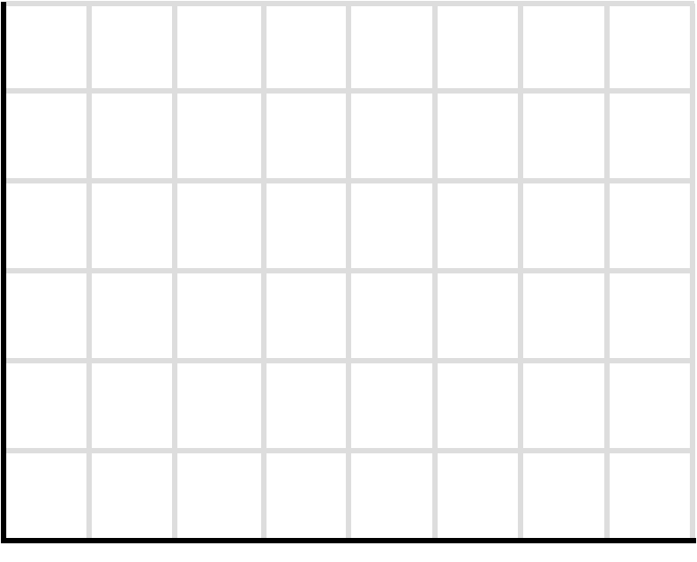
Government-Set Prices
Price Ceiling:
P
S
$3.50
P₀
Ceiling
3.00
P_{C}
D
Shortage
Q_{s}
Q₀
Q_{d}
Q

Slide 14
Government-Set Prices
Price Floors
Prices are set above the market price
Chronic surpluses
Example: Minimum wage laws
LO5
3-14

Slide 15
Government-Set Prices
Price Flooring:
P
Surplus
S
Floor
$3.00
P_{f}
P₀
2.00
D
Q_{d}
Q₀
Q_{s}
Q

Slide 16
A Tax of T=10 Levied on the Seller Shifts the Supply Schedule Upward by T Units
TAXES AND MARKET EQUILIBRIUM
Note: A Tax (T) is a shift factor on the S curve.

Slide 17
Equilibrium Prices and Quantities When a Tax of T = 10 is Levied on the Seller

Slide 18
The Effect of a Tax of T = 10 Levied on the Buyer
Note: A Tax (T) is a shift factor on the D curve.

Slide 19
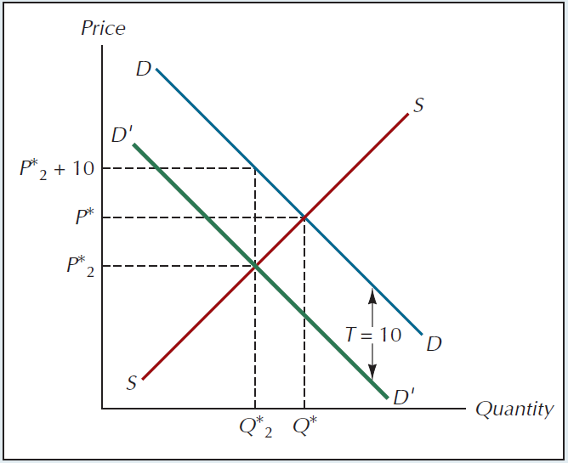
Equilibrium Prices and Quantities after Imposition of a Tax of T = 10 Paid by the Buyer

Slide 20
A Tax on the Buyer Leads to the Same Outcome as a Tax on the Seller
Given: P=Q^{s}; P=10-Q^{d}
At equilibrium, Q^{s}=Q^{d} , therefore set Q =10-Q
Thus, 2Q^{s} =10 or Q^{s}=Q^{d}=5 So P=10-5=$5
Assume Tax of $2 is imposed on the seller
New supply eq. P = Qs + 2, putting Q_{s} = Q^{d}
New equilibrium Q= 4, P = 6, but the seller will receive P= $4 because of $2 tax.
Thus
P_{buyer} =$6;
P_{seller}=$6 - $2= $4
Assume Tax of $2 is imposed on the buyer
New demand eq. P=10-Q^{d}-2, putting Q_{s} = Q^{d}
New equilibrium Q= 4, P= 4, but buyer will pay P= $6 because of $2 tax
Thus
P_{buyer} =$4 + $2 =$6;
P_{seller}=$4

Slide 21
Problems

Slide 22
Problem: Consider a market whose supply and demand curves are given by P= 4Q^{s} and P= 12 - 2Q^{d} respectively. How will the equilibrium price and quantity in this market be affected if a tax of 6 per unit of output is imposed on sellers? If the same is imposed on buyers?
Answer: The original price and quantity are given by P*= 8 and Q* = 2 respectively. The supply curve with the tax is given by P = 4Q^{s} +6. Letting P’ and Q’ denote the new equilibrium values of price and quantity, we now have 6 +4Q’ =12 - 2Q’ which yields Q’=1, P’ =10, where P’ is the price paid by buyers and P’-6=4 is the price received by sellers.
Alternatively, the demand curve with a tax of 6 levied on buyers is given by P=12 -2Q^{d} -6 , and we have 4Q’ =6’ – 2Q’ which yields Q’=1 and P”=4 where P” is the price received by sellers. That is, P”+T = P” + 6 = 10 is the price paid by buyers.

Slide 23
Question: Suppose demand for seats at football games is P = 1900 – (1/50)Q and supply is fixed at Q =90,000 seats.
Find the equilibrium price and quantity of seats for a football game (using algebra and a graph).
Suppose the government prohibits ticket scalping (selling tickets above their face value), and the face value of tickets is $50 (this policy places a pricing ceiling at $50). How many consumers will be dissatisfied (how large is excess demand)?
Suppose the next game is a major rivalry, so demand jumps to P = 2100 – (1/50)Q. How many consumers will be dissatisfied with this game?
How do distortions of this price ceiling differ from the more typical case of upward-sloping supply?
Answer:
a) The equilibrium quantity is Q = 90,000 seats and the equilibrium price is P = 1900 – (1/50)(90,000) = 1900 – 1800 = $100.
b) At a price ceiling of P = $50, quantity demanded is found by solving 50 = 1900 – (1/50)Q for Q = 92,500 seats. Since the stadium only holds Q = 90,000 seats, there will be 92,500 – 90,000 = 2,500 dissatisfied fans who want to buy a ticket at P = $50 but cannot find one available.
c) Quantity demanded for the higher demand is found by solving 50 = 2100 – (1/50)Q for Q = 102,500 seats. Now there will be 102,500 – 90,000 = 12,500 dissatisfied fans who want to buy a ticket at P = $50 but cannot find one available. The excess demand is12,500 – 2,500 = 10,000 seats more than for the not so big game.
d) Normally a price ceiling both raises quantity demanded and lowers quantity supplied. Here, only the first effect is present because the stadium capacity is fixed.
S
$300
D’
D
$100
$50
102.5
0
90
92.5
105

Slide 24
A senior has accumulated a number of tests during his college career. Now he wants to sell his test collection. 3 friends express interest in buying the tests. Their individual demand equations are as follows:
P = 30.00 – 1.0 Q₁
P = 30.00 – 1.33Q₂
P = 30.00 – 0.8Q₃
What is the market demand for the tests and how many more tests can be sold for each one-dollar decrease in price? If he has a file of 60 tests, what price should he charge to sell his entire collection?
Q_{m} = Q₁ + Q₂ + Q₃
Q_{m} = (30.00 - 1.00P) + (22.5 - 0.75P) + (37.50 - 1.25P)
Q_{m} = 90.00 - 3.00P
Given: Q_{m} = 60, then
60 = 90.00 - 3.00P
P = 10.00

